Slide 1

Selenium Web Test Tool Training
Using Ruby Language
Kavin School Presents:
Discover the automating power of Selenium
Presented by:
Kangeyan Passoubady (Kangs)
Copy Right: 2008, All rights reserved by Kangeyan Passoubady (Kangs). Republishing requires author’s permission

Slide 2
1
Day
Installing Selenium IDE

Slide 3
Installing Selenium IDE
Installing Selenium is a two step process
  First: If Firefox is not installed in your machine then Install Firefox
  Second: If Selenium IDE is not installed on your machine then Install Selenium IDE Plug-in

Slide 4
IE Version of Selenium
Is there an IE version of Selenium IDE?
  No, at this point of time Selenium IDE works only for Firefox. You can write your test scripts via IDE and then use the Selenium Core TestRunner or Selenium RC to execute them on IE.

Slide 5
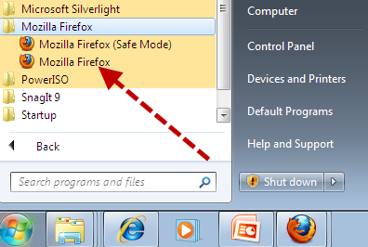
Check Firefox Exist
Check whether your machine already has a version of Firefox installed.
Go to Start → Programs → Mozilla Firefox

Slide 6
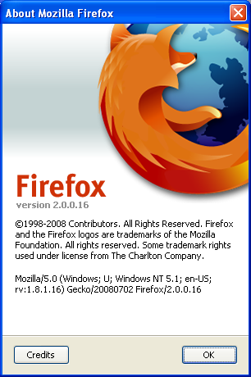
Check Firefox Version
Click on the Mozilla Firefox
Go to Help → About as shown below:
Check the version name
What is your version?
In this About Window, it shows Firefox version 2.0.0.16

Slide 7

Install Firefox #1
Open your IE browser (or any other browser), only if you don’t have a Firefox browser.
In the address bar enter:
  http://www.mozilla.com/en-US/firefox/
Click the “Free Download”
Install the latest version of Firefox 3.x, only if you don’t have a prior version of Firefox installed on your machine

Slide 8
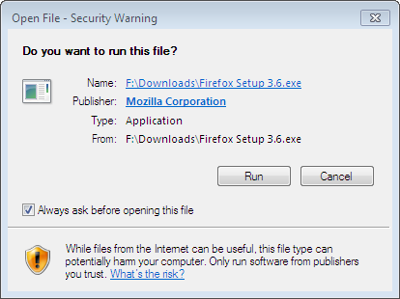
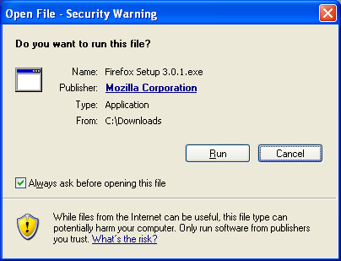
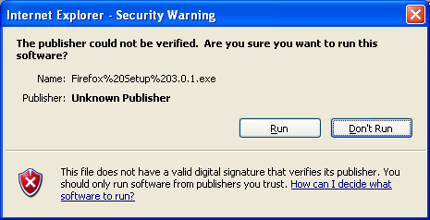
Install Firefox #2
Follow the steps and run the program (*1)
  Saving into local machine then running is recommended
If prompted with Security warning, press “Run” button (*2 & *3)
*1
Save into your local machine. (C:\Downloads)
Run (double click Firefox Setup 3.x.x) from the location where you downloaded
Ignore Security warning and press “Run” button
*2
*3

Slide 9
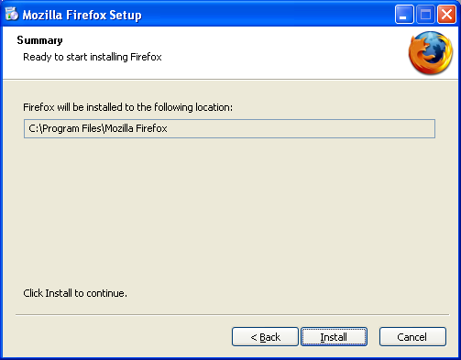
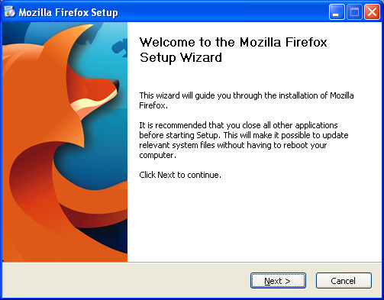
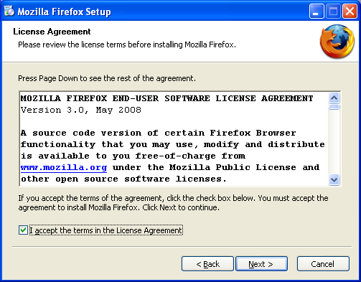
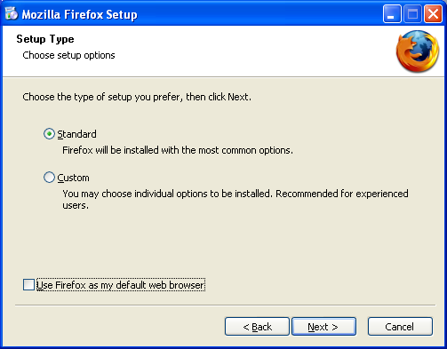
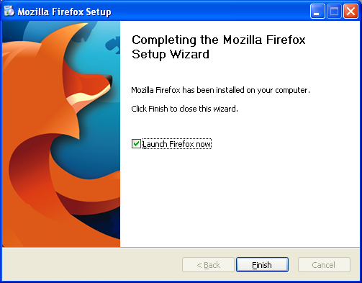
Installing Firefox #3
Press Next (*1)
Check the “I Accept” then Press Next (*2)
Select Standard, Remove check from “Use Firefox as my default browser” (*3)
Press Install button (*4)
Press Finish button (*5)
*4
Just follow the steps of installation as shown below
*1
*2
*3
*5

Slide 10
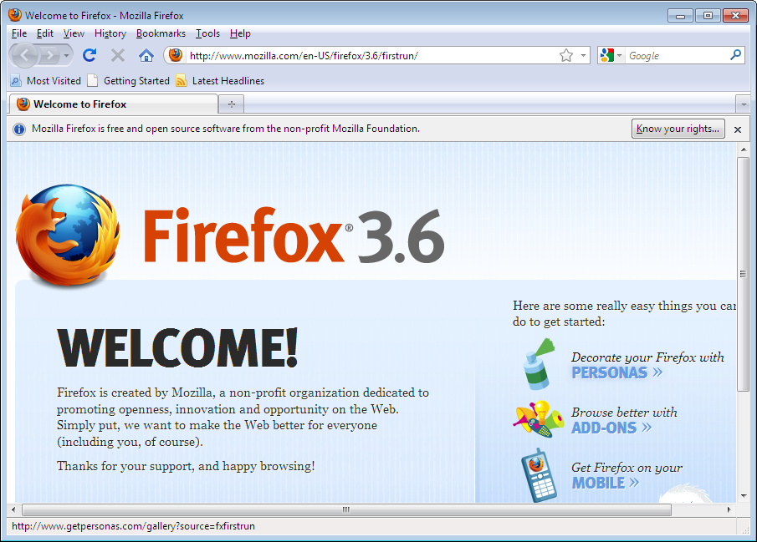
Installing Firefox #4
*6
You have successfully installed Firefox

Slide 11
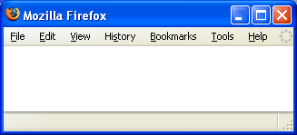
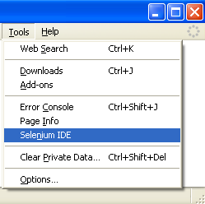
Installing Selenium IDE #1
Open the Firefox browser window (*1)
Go to Tools → Check whether Selenium IDE already exist there (*2)
If you see “Selenium IDE”, Hurray, You are already having Selenium IDE plug-in is installed in your Firefox browser
If not installed then follow the instruction on the next slide
*1
*2
Check whether Selenium IDE is already installed

Slide 12
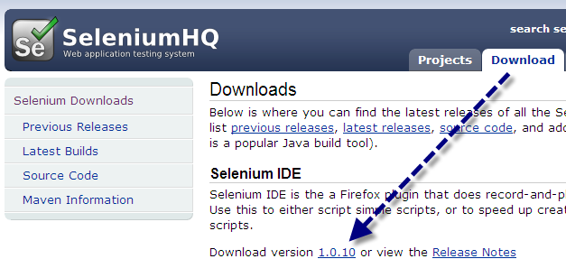
Installing Selenium IDE #2
Open the Firefox browser window (*1)
In the navigation tool bar type the below URL:
  http://seleniumhq.org/download/
  Under Downloads Choose Selenium IDE(*1)
Don’t do this in IE browser
*3
*2
Click download

Slide 13
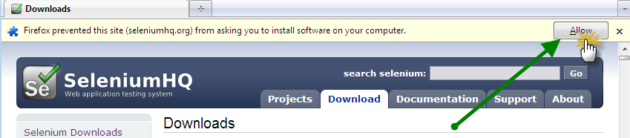
Installing Selenium IDE #3
Click Allow if Firefox prevents to install (*4)
*4
Click Allow

Slide 14
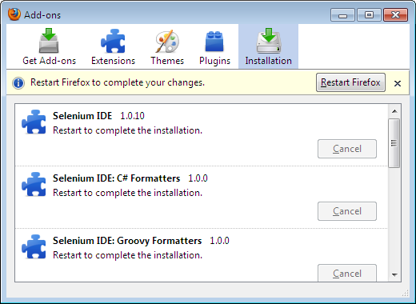
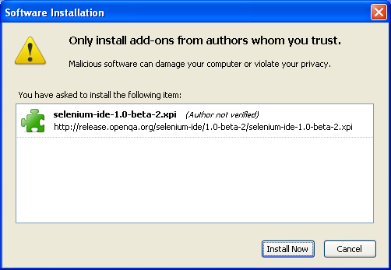
Installing Selenium IDE #5
When the Software Installation Window appears, select “Selenium IDE” (*5)
Press Install button
“Selenium IDE” Add on is installed (*6)
Click on “Restart Firefox” button(*6)
*6
*5
Restart to take effect of the Selenium Plug-in

Slide 15
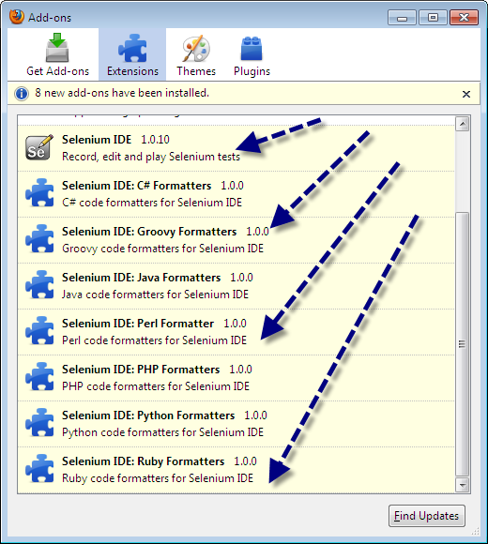
Installing Selenium IDE #6
When you install Selenium IDE, along with it all the Selenium IDE language formatters also gets installed (*7)
*7
Selenium IDE and Formatters are installed

Slide 16
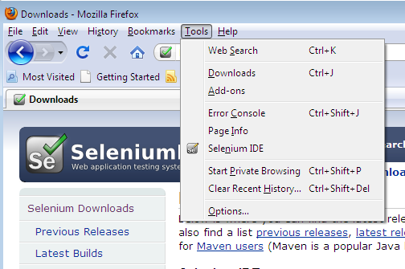
Installing Selenium IDE #8
Now, in the Firefox browser go to Tools and verify whether “Selenium IDE” is displayed (*8).
If found, then the Selenium IDE installation is completed. (Congrats !)
*8
Selenium IDE is successfully installed

Slide 17
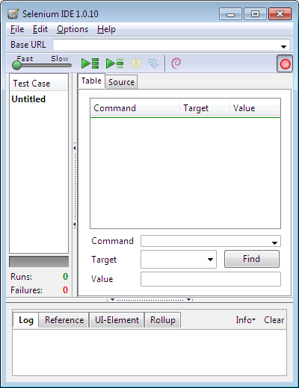
Installing Selenium IDE #9
Click Selenium IDE in the menu which will bring the Selenium IDE to you (*9)
*9
Selenium IDE is successfully installed

Slide 18
Selenium IDE - Questions
#1
Why do you choose Selenium over QTP for automation?
What are the limitations of Selenium?
Find the advantages of following testing Tools:
  Watir/WET
  LiquidTest
  StoryTestIQ (STIQ)
  Bromine
  CubicTest
  Frankenstein

Slide 19
Selenium IDE - Questions
#2
Find the advantages of following testing frameworks:
  JUnit,TestNG (Java)
  NUnit (.Net)
  Unittest(Python)
  RSpec, Test::Unit (Ruby)

Slide 20
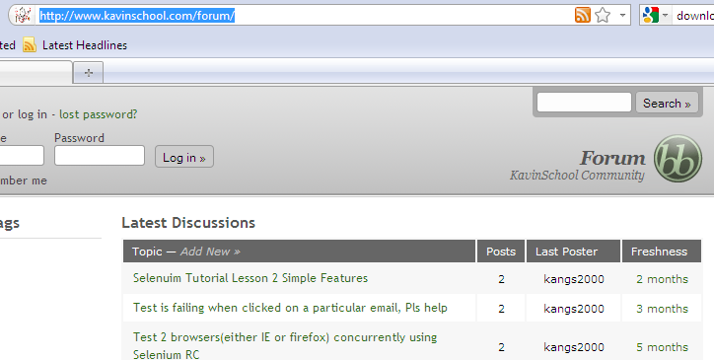
Check KavinSchool Forum
#1
Check Kavin School Forum for the alumni students answers
Click the below URL
http://www.kavinschool.com/forum/
If you have any Selenium related questions post in the forum

